Slide 1
XYZ23 Microprocessor
Leo Chen, Thomas Poimenidis, Michael Waetzman, Zhiheng Xu
Group: XYZ (#14)
Project: Microprocessor
Notes:
Mike

Slide 2
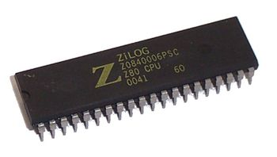
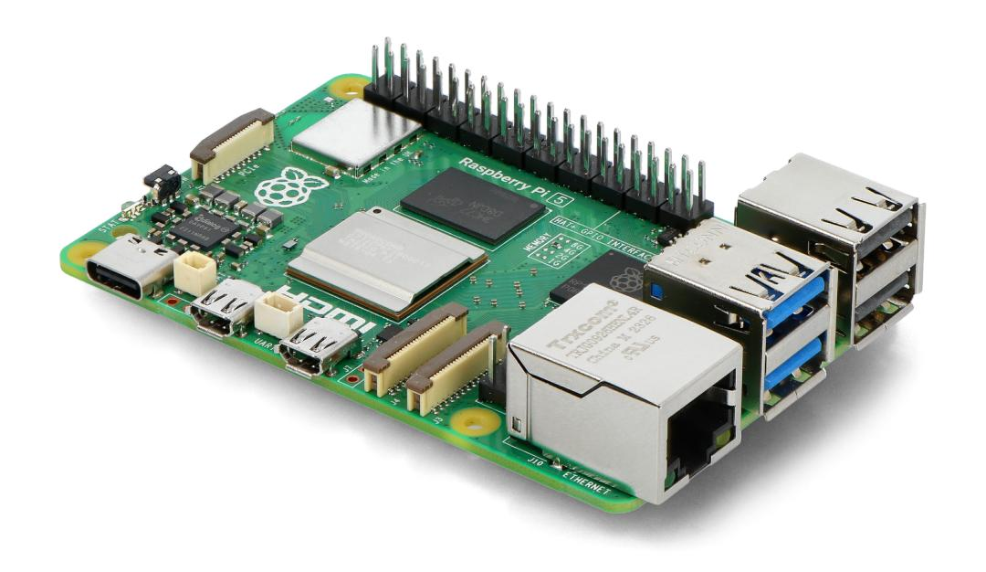
Goal/Motivation
Create a microprocessor from first principles
Accepts a .xyz file containing instructions
Assembles the program and sends binary file to MPU
Results are returned!
Inspiration Material:
EC327 Simplified Intel Assembly
Raspberry Pi (microcontroller, not a microprocessor)
MOS 6502
Zilog Z80
Notes:
Mike

Slide 3
General Structure
Notes:
Thomas

Slide 4
Functionality/Operations
Allows users to write code capable of execution via FPGA (good for simulation purposes)
FPGAs are easily reprogrammable, meaning new operations can easily be added (i.e. updated versions of XYZ language)
May not be as optimized as an ASIC, but the flexibility makes up for that.
Allows for easy-to-read inputs and outputs.
The user no longer has to deal with binary. All inputs and outputs are displayed in decimal. The decoder converts values to binary and vice versa all behind the scenes.
Notes:
Thomas

Slide 5
Project “Flow”
User Codes in XYZ “Assembly” Language
Program assembles via the XYZassembler (C++)
Binary file sent to FPGA via UART
Top module loads file into memory
Top module reads and executes instructions in memory until reaching a HALT code
FPGA dumps memory via UART
Memory dump is displayed in easy to read format (C++)
Notes:
Thomas

Slide 6
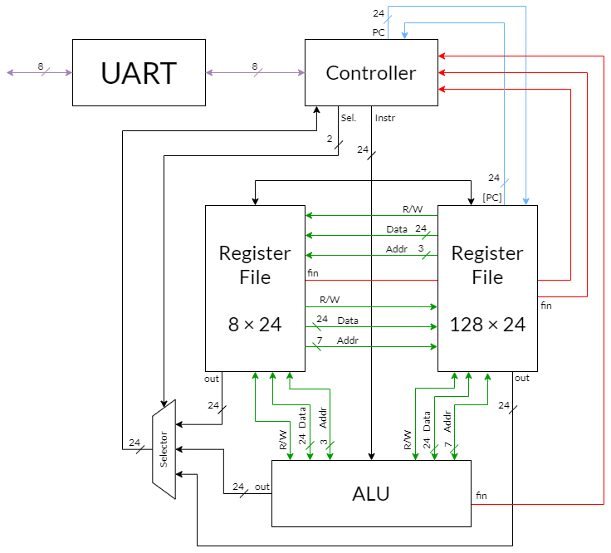

Memory
Project Block Diagram
Notes:
Thomas

Slide 7
Modules

Slide 8
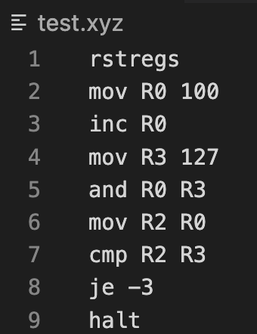
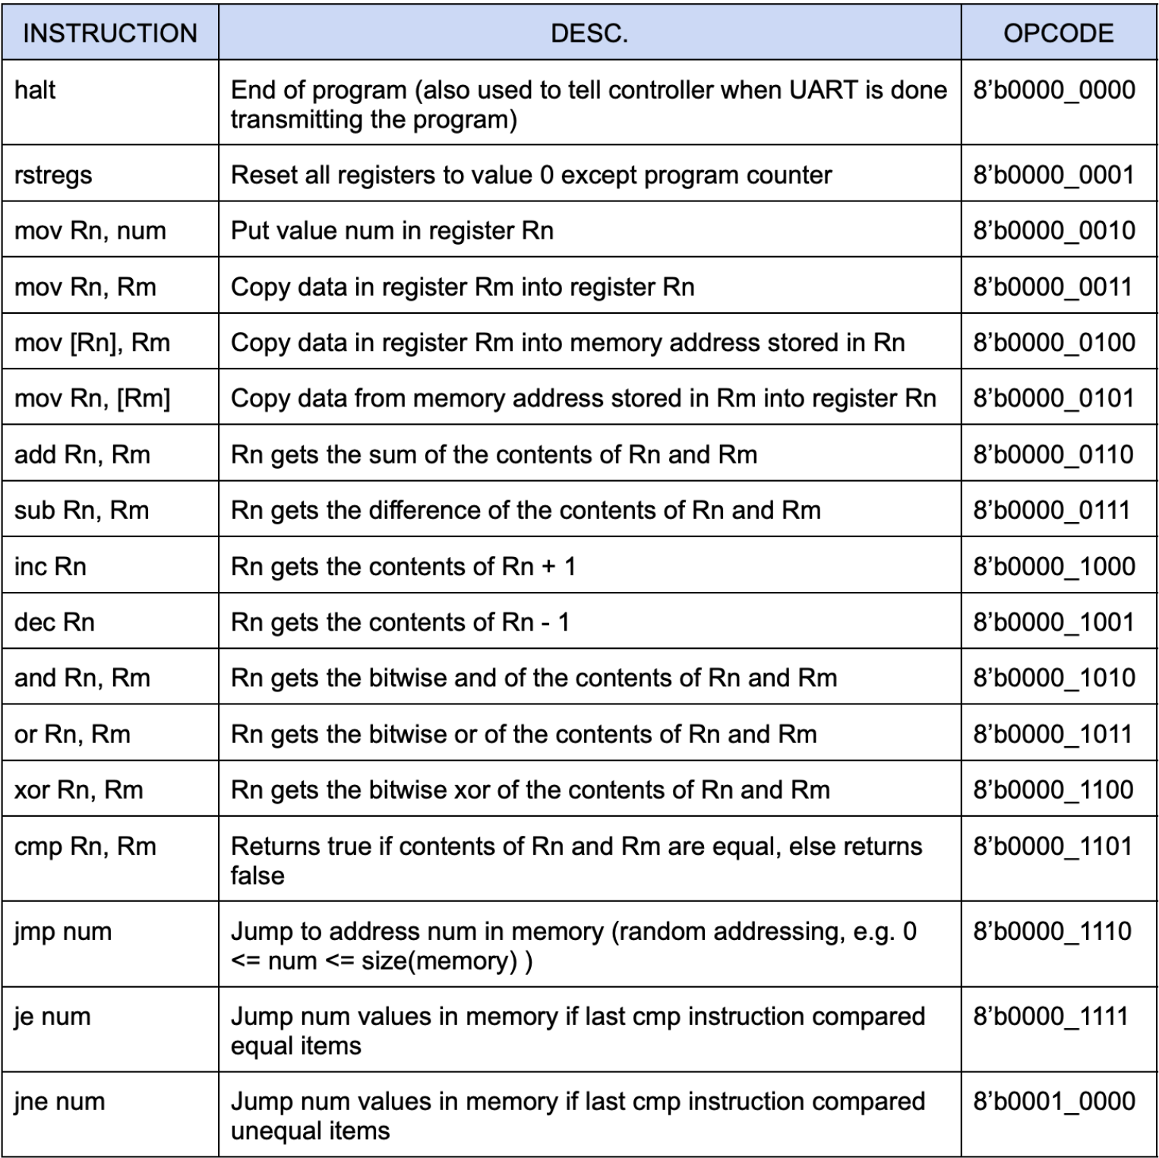
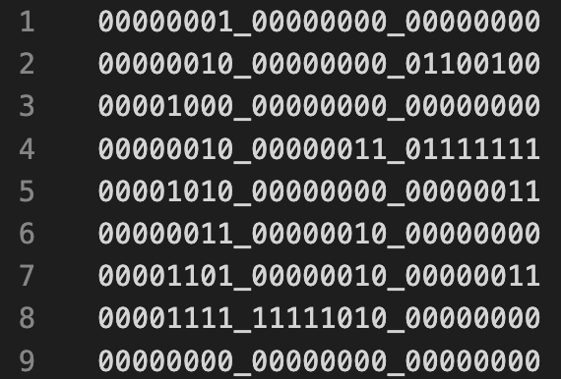
XYZ Assembly + Assembler
Start by writing a program in XYZ assembly
Assemble using XYZassembler.cpp
Get .BIN file used to push program to the FPGA
XYZ Instruction Set
Notes:
Thomas

Slide 9
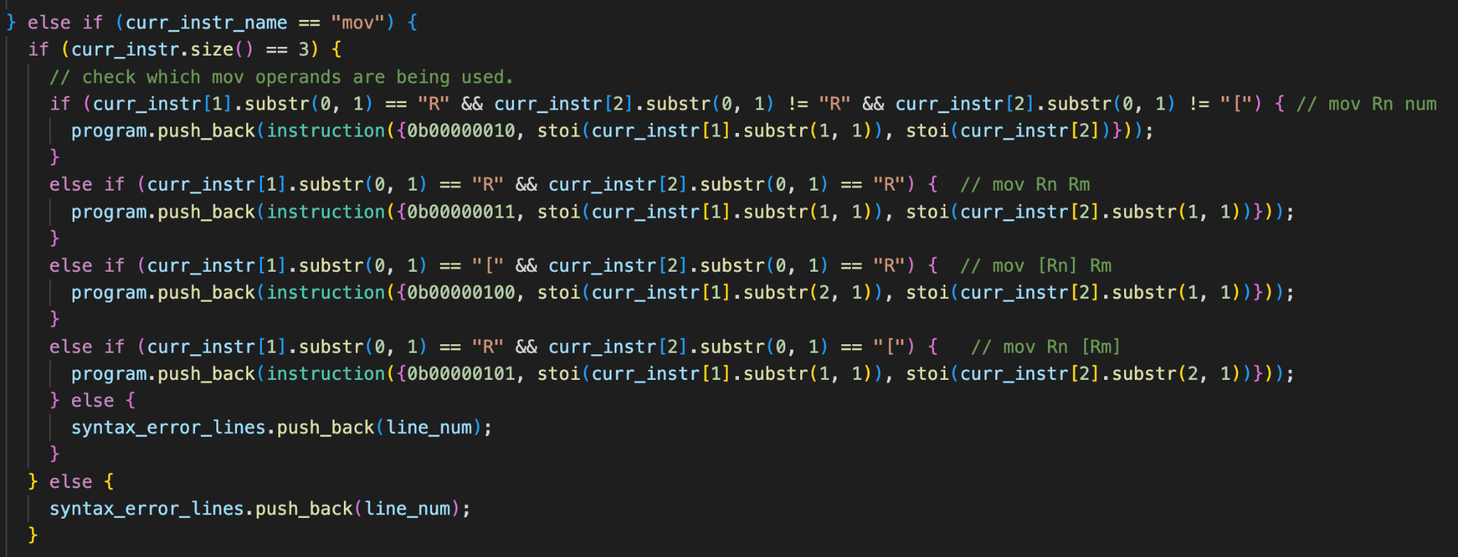
XYZ Assembler Code Snippet
Once a ‘mov’ instruction has been detected, check what the operands are so that the correct binary value is assigned to the instruction. If not valid, log syntax error.
Still in the process of detecting all syntax errors.
Notes:
Thomas Leo

Slide 10
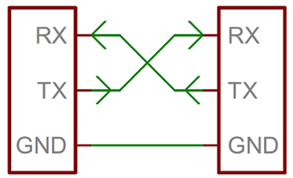
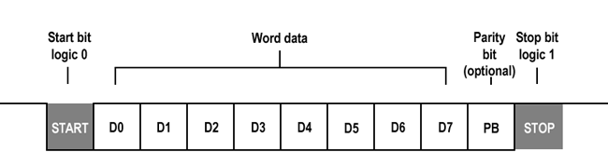
UART Protocol
Universal Asynchronous Receiver / Transmitter
Method for sending/receiving data WITHOUT a shared clock!
Great for communication between systems
Used to send binary to and from the FPGA
Notes:
Mike

Slide 11
Controller (CPU)
CPU is the central module in our microprocessor.
It decides which module each instruction should go to. The general process is first storing all the instructions in memory file and starting proceeding one by one from the beginning.
halt | End of program (also used to tell controller when UART is done transmitting the program) | 8’b0000_0000
Notes:
Leo

Slide 12
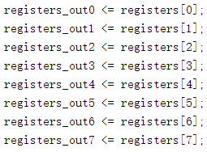
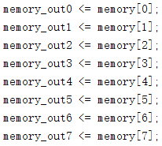
Controller (Testbench)
output reg [23:0] registers_out [0:7] Verilog can’t recognize 2D array as it thinks they are
=8 * 24 bits register memory. To easily test the controller, we made
output reg [23:0] memory_out [127:0] another module with all registers and 8 memory cells
=128 * 24 bits memory as outputs.
Notes:
Leo

Slide 13
Register File
In the regfile, we have 8 registers, each with 24 bits.
Controlled by the CPU, It does following operations.
mov Rn, num | Put value num in register Rn | 8’b0000_0010
mov Rn, Rm | Copy data in register Rm into register Rn | 8’b0000_0011
mov [Rn], Rm | Copy data in register Rm into memory address stored in Rn | 8’b0000_0100
mov Rn, [Rm] | Copy data from memory address stored in Rm into register Rn | 8’b0000_0101
Notes:
Leo

Slide 14
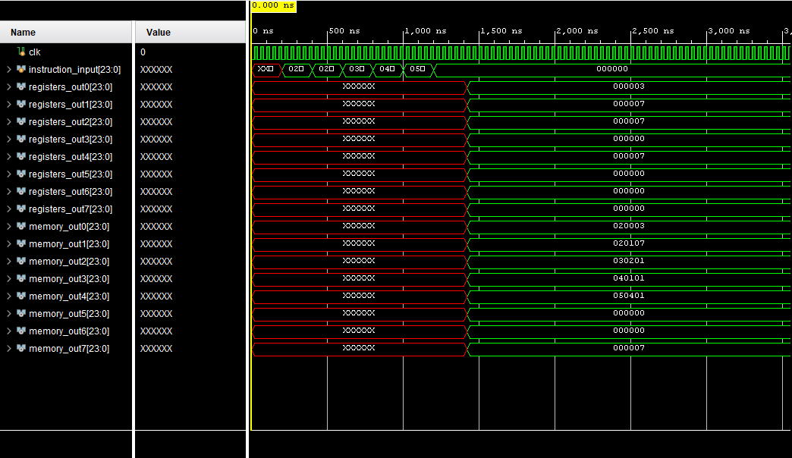
Register File (testbench)
Mov R0 3 | Assign 3 to R0 | R0 | 3 | ✔
Mov R1 7 | Assign 7 to R1 | R1 | 7 | ✔
Mov R2 R1 | Assign R1 to R2 | R2 | 7 | ✔
Mov [R1] R1 | Assign Address [7] R1 | Address [7] | 7 | ✔
Mov R4 [R1] | Assign R4 Address[7] | R4 | 7 | ✔
Address [0] | 24’b00000010_00000000_00000011 | ✔
Address [1] | 24’b00000010_00000001_00000011 | ✔
Address [2] | 24’b00000011_00000010_00000001 | ✔
Address [3] | 24’b00000100_00000001_00000001 | ✔
Address [4] | 24’b00000101_00000100_00000001 | ✔
Address [5] | 24’b00000000_00000000_00000000 (Halt) | ✔
Notes:
Leo

Slide 15
ALU
The ALU module covers all the calculations we need.
add Rn, Rm | Rn gets the sum of the contents of Rn and Rm | 8’b0000_0110
sub Rn, Rm | Rn gets the difference of the contents of Rn and Rm | 8’b0000_0111
inc Rn | Rn gets the contents of Rn + 1 | 8’b0000_1000
dec Rn | Rn gets the contents of Rn - 1 | 8’b0000_1001
and Rn, Rm | Rn gets the bitwise and of the contents of Rn and Rm | 8’b0000_1010
or Rn, Rm | Rn gets the bitwise or of the contents of Rn and Rm | 8’b0000_1011
xor Rn, Rm | Rn gets the bitwise xor of the contents of Rn and Rm | 8’b0000_1100
cmp Rn, Rm | Returns true if contents of Rn and Rm are equal, else returns false | 8’b0000_1101
Notes:
Alan

Slide 16
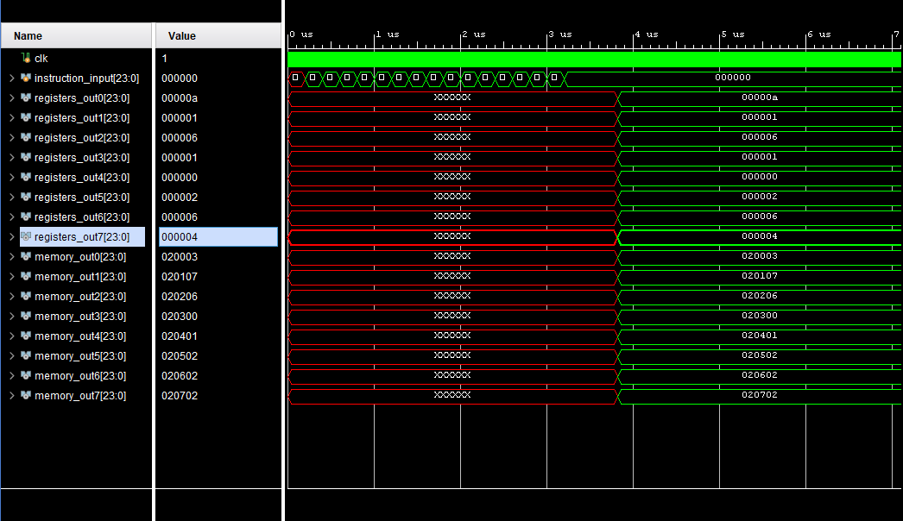
ALU (testbench)
Mov R0 3 | Assign 3 to R0 | R0 | 3
Mov R1 7 | Assign 7 to R1 | R1 | 7
Mov R2 6 | Assign 6 to R2 | R2 | 6
Mov R3 0 | Assign 0 to R3 | R3 | 0
Mov R4 1 | Assign 1 to R4 | R4 | 1
Mov R5 2 | Assign 2 to R5 | R5 | 2
Mov R6 2 | Assign 2 to R6 | R6 | 7
Mov R7 2 | Assign 2 to R7 | R7 | 2
Add R0 R1 | Add R0, R1 | R0 | 10 | ✔
Sub R1 R2 | Sub R1 R2 | R1 | 1 | ✔
Inc R3 | Increase R3 by 1 | R3 | 1 | ✔
Dec R4 | Decrease R4 by 1 | R4 | 0 | ✔
And R5, R2 | 010 & 110 = 010 | R5 | 2 | ✔
Or R6, R2 | 010 | 110 = 110 | R6 | 6 | ✔
Xor R7, R2 | 010 ^ 110 = 100 | R7 | 4 | ✔
Notes:
Alan

Slide 17
Memory
We have 128 memory cells, each with 24 bits.
It stores all the instructions from the uart.
jmp num | Jump to address num in memory (random addressing, e.g. 0 <= num <= size(memory) ) | 8’b0000_1110
je num | Jump num values in memory if last cmp instruction compared equal items | 8’b0000_1111
jne num | Jump num values in memory if last cmp instruction compared unequal items | 8’b0001_0000
Notes:
Alan

Slide 18
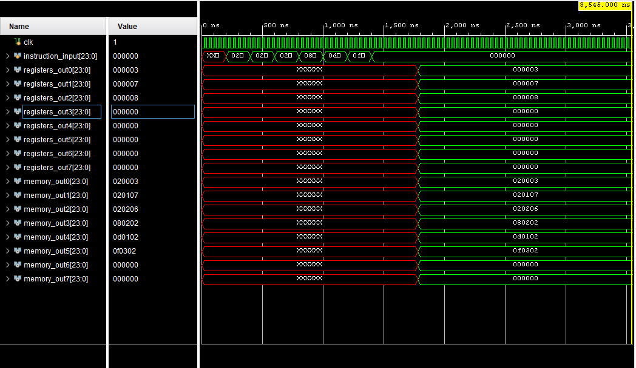
Memory (testbench)
Mov R0 3 | Assign 3 to R0 | R0 | 3
Mov R1 7 | Assign 7 to R1 | R1 | 7
Mov R2 6 | Assign 6 to R2 | R2 | 6
Inc R2 | Increase R2 by 1 | R2 | 7
Cmp R2, R1 | Compare R2 and R1 | cmp_result | 1 | ✔
Je 3 | Jump to address [3] if (cmp_result ==1) |  |  | ✔
Inc R2 | Increase R2 by 1 | R2 | 8 | ✔
Cmp R2, R1 | Compare R2 and R1 | cmp_result | 0 | ✔
Notes:
Alan

Slide 19
Review & Discussion

Slide 20
Successes
C++ XYZcompiler works properly
Done from first principles (using most things we did in class)
We got the instructions to operate properly in Verilog
Notes:
Mike

Slide 21
Failures/T0-Do
UART → Sending/Receiving .bin files
Modularity
Modeled a single-cycle CPU, all in one file → would rather have modules
Requires more data-transfer controls
Create a Linker (if there is time)
Allow users to compile multiple files without overwriting one another
Format Output (memory dump)
Use C++ to format output with decimal values
Notes:
Mike

Slide 22
Work Distribution
Topic | Description | Member
Assembler + Decoder (C++) | Translates user-written code into binary instructions for our MCU (and vice-versa) | Thomas
UART Implementation | Sending data to and from the FPGA | Mike
Controller (CPU) | Manges how instructions are executed, as well as where data is sent | All :)
ALU | Standard ALU, essentially a modified ALU from Lab 2 | Leo & Zhiheng
Register File | 7×24 bit registers to store temporary information | Leo & Zhiheng
Memory | 128×24 bit memory to store information | Thomas & Mike
General Connections | Separate jobs to different modules based on assembly code | Thomas & Mike
Notes:
Mike

Slide 23

https://github.com/mwae-bu/EC311-XYZ-Final_Project.git
Notes:
Mike

